Slide 1
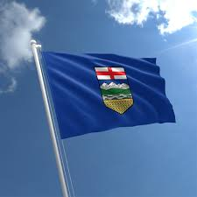
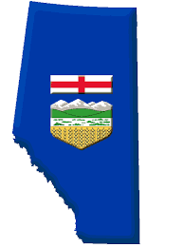
Becoming A Province

Slide 2
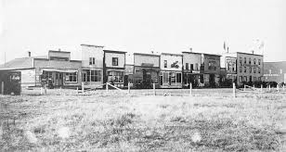
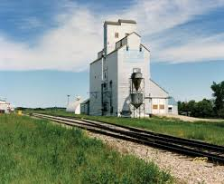
How Did Communities Grow?
Different kinds of communities grew in Alberta. Many had one thing in common: a spirit of cooperation. For most, helping one another was a way of life. People worked together to help their communities grow. People often settled near others with the same homeland or religion.
Mormons settled in Cardston
Scandinavians settled near Camrose, New Norway, & Wetaskiwin
Icelandic immigrants settled in the Red Deer area
Germans settled first in Pincher Creek & Medicine Hat, then further north to Bruderheim & Stoney Plain
In all these places, people worked together to build places of worship and schools. Grain elevators were built along the railway tracks to sell their wheat. Gradually, stores, restaurants and hotels were built.

Slide 3
Why Become a Province?
The government of Alberta had been collecting taxes for services, but more was needed
The government didn’t want to ask settlers for more money or they might move away
Alberta asked the Canadian government for money each year (like an allowance!), if they joined Canada they would just be given money without asking
Also if Alberta became a province it would take more control of its resources (coal, wheat, timber)
Another reason is if Alberta became a province it could make its own decisions and make its own laws

Slide 4
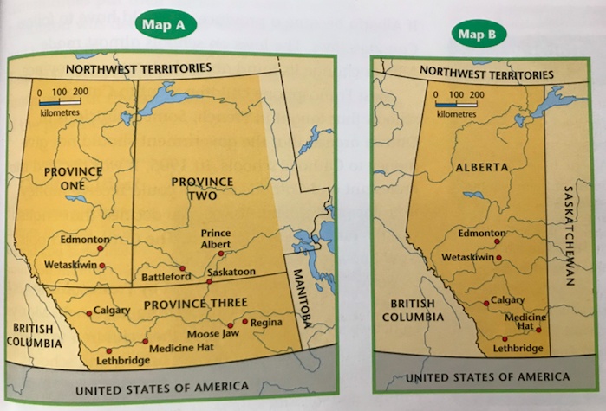
What Will the Border Be?
People had different opinions about how the land should be divided. Some wanted one big province because they thought the government in Ottawa would pay more attention to a large province. Some wanted two provinces so that each provincial government could be closer to the people of the province.
Notes:
Look at Map A: If province three had become Alberta, which cities would not have been in this province? How might your life be different if Province Three had become Alberta?

Slide 5
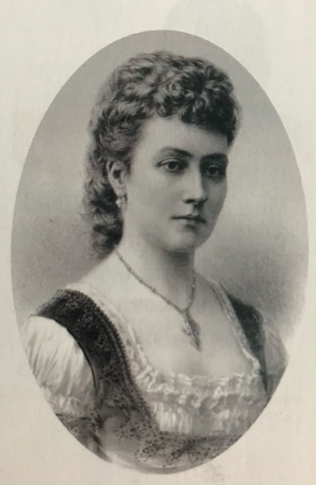
Alberta or Buffalo?
The plan to make a new province went ahead, but the province needed a name. Once again, there was much debate. Frederick Haultain (premier of the North West Territories) wanted the new province to be called Buffalo. Some people wanted the name Alberta, to honour Princess Louise Caroline Alberta. She was the daughter of Queen Victoria, who had been the queen of England and Canada. As you know, Alberta was the name that was finally chosen.
The new province needed a capital city. Several communities put their name forward including: Calgary, Red Deer, Banff, Vegreville, Wetaskiwan, and Edmonton. In 1906, Edmonton was declared the winner. Why? Edmonton had been settled since it was a fur-trading post more that 100 years earlier. It was also the largest community at the time and was located in the centre of the province.

Slide 6
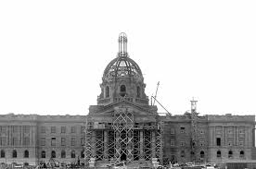
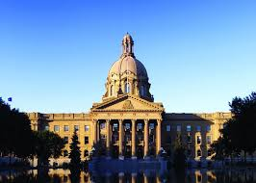
Alberta Becomes a Province!
It took years of discussion and debate to answer all the questions. How many provinces would there be? What would the borders be? During this time, people wrote letters and reports to Ottawa. They held meetings. They debated with each other.
At last, in 1905, Alberta became a province, with its own provincial government. Now the new province could make decisions for its people.

Slide 7
The population of a province is all the people who live there. A diverse population is made up of people from many different cultures and backgrounds.
After Alberta become a province, its population become more diverse. People came from different cultures and from many different countries. Some immigrants came from the United States, Scotland, Ireland, and Belgium. Others came from Russia, Germany, Italy, and China. They brought their families and traditions to Alberta.
Some settlers who came to farm didn't do as well as others, so they moved to the cities. Sometimes workers who had built the railway stayed once it was finished. Some people planned from the start to live in towns and cities. They came to open shops and other businesses, or to work in schools or hospitals.

Slide 8
Pg. 226
Let’s look at some perspectives from page 226 of the text book.

